Slide 1
Chapter 4 Recurrences

Slide 2
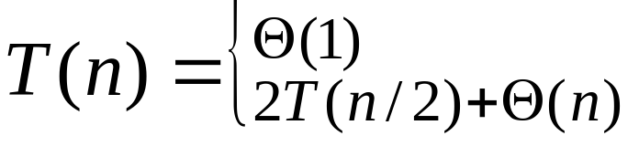
Introduction
A recurrence is an equation or inequality that describes a function in terms of its value on smaller inputs
Three methods for solving recurrences
  Substitution method
  Recursion-tree method
  Master method
Notes – some technical details are neglected
  Assumption of integer arguments to functions: T(n)
  Boundary condition for small n → T(n) is constant for small n
  Floors, ceilings
If n = 1
Θ(nlgn)
If n > 1

Slide 3
Recursion-Tree Method

Slide 4
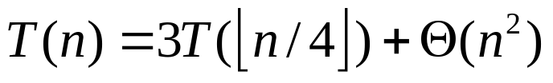
Basic concept
Recursion tree
  Each node represents the cost of a single subproblem somewhere in the set of recursive function invocations
  Sum the costs within each level of the tree to obtain a set of per-level costs
  Sum all the per-level costs to determine the total cost of all levels of the recursion
Useful when the recurrence describes the running time of a divide-and-conquer algorithm
Useful for generating a good guess, which is then verified by the substitution method
  Sloppiness are allowed
Example:
  Ignore the floors and write out the implicit coefficient c > 0 (sloppiness)

Slide 5
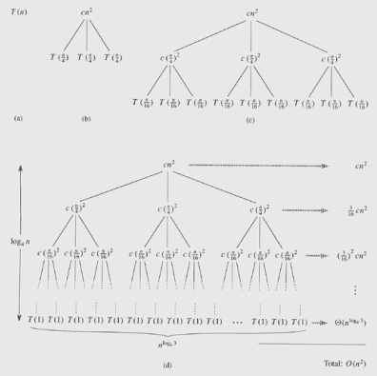
Recurrence tree for T(n)=3T(n/4) + cn²

Slide 6


T(n)=3T(n/4) + cn²
Depth(x) is the length of the simple path from root to a node x.
The subproblem size for a node at depth i is n/4^{i}
  When the subproblem size becomes1? ➔ When n/4^{i} = 1➔i=log₄n
  The tree has log₄n+1 levels (0, 1, 2,.., log₄n)
The cost at each level of the tree (0, 1, 2,.., log₄n-1)
  Number of nodes at depth i is 3^{i}
  Each node at depth i has a cost of c(n/4^{i})²
  The total cost over all nodes at depth i is 3^{i} c(n/4^{i})²=(3/16)^{i}cn²
The cost at depth log₄n (i.e., last level) is
  Number of nodes is 3^{i} =
  Each contributing cost T(1)
  The total cost

Slide 7
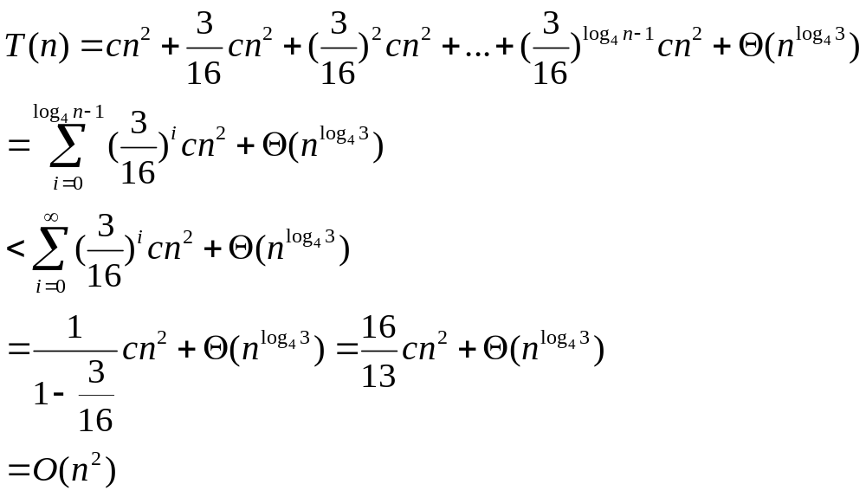
T(n)=3T(n/4) + cn² (Cont.)

Slide 8


T(n)=2T(n/2) + cn
The subproblem size for a node at depth i is n/2^{i}
  When the subproblem size is1? ➔ When n/2^{i} = 1➔i=log₂n
  The tree has log₂n+1 levels (0, 1, 2,.., log₂n)
The cost at each level of the tree (0, 1, 2,.., log₂n-1)
  Number of nodes at depth i is 2^{i}
  Each node at depth i has a cost of c(n/2^{i})
  The total cost over all nodes at depth i is 2^{i} c(n/2^{i})=cn
The cost at depth log₂n (i.e., at the last level) is
  Number of nodes is
  Each contributing cost T(1)
  The total cost

Slide 9
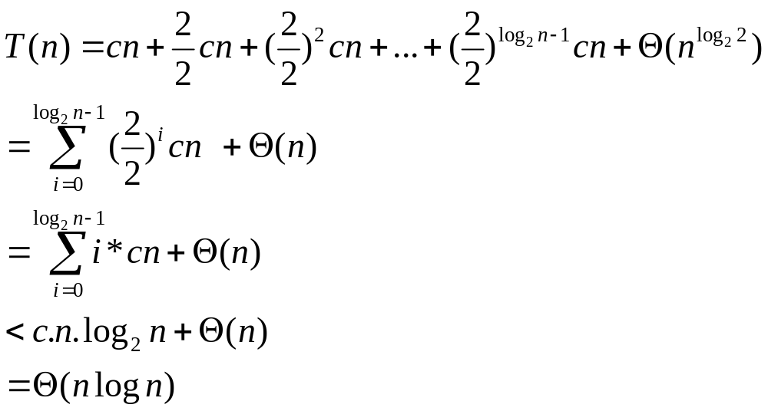
T(n)=2T(n/2) + cn (Cont.)

Slide 10
T(n)=2T(n/2) + 1
Draw the recursive tree by yourself or see this ➔ 1 The subproblem size for a node at depth i is n/2^{i 1 1}
  When the subproblem size is1? ➔ When n/2^{i} = 1 1 1 1 1
  ➔i=log₂n. The tree has log₂n+1 levels (0, 1, 2,.., log₂n)
The cost at each level of the tree (0, 1, 2,.., log₂n-1)
  Number of nodes at depth i is 2^{i}
  Each node at depth i has a cost of 1
  The total cost over all nodes at depth i is 2^{i} * 1 = 2^{i}
The cost at depth log₂n(i.e., at the last level) is
  Number of nodes at the last level is 2^{i} ₌ 2^{lg n} = n
  Each contributing cost T(1)
  The total cost at the last level is

Slide 11
T(n)=2T(n/2) + 1 (Cont.)
The total cost spent from level 0 to level log n-1 is
2^0 + 2^1 + 2^2 + …. + 2^{log n-1} = 2^{logn} = n
The total cost spent at the last level is also n.
Therefore, n+n = 2n = O(n).

Slide 12
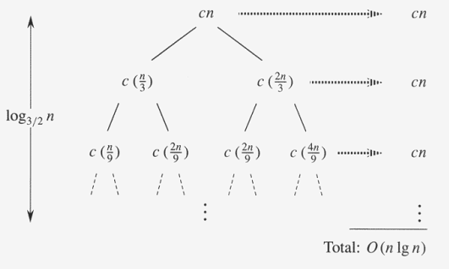
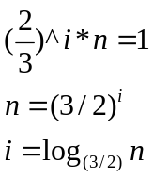
A recursion tree for T(n)=T(n/3) + T(2n/3) + cn

Slide 13

T(n)=T(n/3) + T(2n/3) + cn
# of levels * cost of each level = O(cn log_{3/2} n)=O(n lg n)
Complication
  If the tree is complete binary tree, # of leaves =
  But the tree is not complete
  Go down from the root, more and more internal nodes are absent
Verify O(n lg n) is an upper bound by the substitution method.

Slide 14
The Master Method

Slide 15

Basic concept
Cookbook for solving
  Describe the running time of an algorithm that divides a problem of size n into a subproblems, each of size n/b
  a ≥ 1 and b > 1 (constant), f(n): asymptotically positive
  Require memorization of three cases
  Floor and ceiling functions are omitted

Slide 16







Master Theorem
can be bounded asymptotically as follows
  If (ε > 0), then
  If , then
  If (ε > 0), and if af(n/b) ≤ cf(n) for some constant c < 1 and all sufficiently large n, then
The solution is determined by the larger of f(n) and
  Case 1: f(n) must be polynomially smaller than
    f(n) must be asymptotically smaller than by a factor of n^{ε}
  Case 3: f(n) must be polynomially larger than , and in addition satisfy the regularity condition that af(n/b) ≤ cf(n)
The three cases do not cover all possibilities for f(n)

Slide 17

Using the master method
Example 1: T(n)=9T(n/3) + n (Case 1)
  a=9, b=3, f(n) = n
  T(n) = θ(n²)
Example 2: T(n) = T(2n/3) + 1 (Case 2)
  a=1, b=3/2, f(n)=1
  T(n) = θ(lg n)

Slide 18




Using the master method (Cont.)
Example 3: T(n) = 3T(n/4) + n lg n (Case 3)
  a=3, b=4, f(n) = n lg n
  For sufficiently large n, af(n/b) = 3(n/4)lg(n/4) ≤ (3/4)n lg n=cf(n) for c=3/4
  T(n) = θ(n lg n)
Example 4: T(n) = 2T(n/2) + n lg n
  a=2, b=2, f(n) = n lg n
  Falls into the gap between case 2 and case 3
(ε ≈0.2)
(Asymptotically less than n^{ε} for any ε )

Slide 19


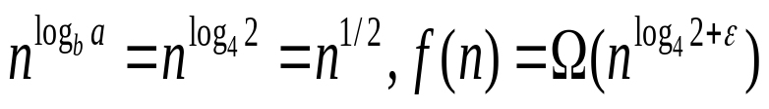
Using the master method (More examples Cont.)
Example 5: T(n) = 4T(n/2) + n (Case 1)
  a=4, b=2, f(n) = n
  T(n) = θ(n²)
Example 6: T(n) = 4T(n/2) + n² (Case 2)
  a=4, b=4, f(n) = n²
  Example 7: T(n) = 2 T(n/4) + n
  - a = 2, b = 4, f(n) = n
  For sufficiently large n, af(n/b) = 2(n/4) ≤ (1/2)n =cf(n) for c=1/2 < 1. T(n) = θ(n)
  Example 7: T(n) = 3 T(n/2) + n^{2.} answer: θ(n²)

